Slide 1
IMM 120
Object-Oriented Programming – Nov 12

Slide 2
Previously, in IMM120
Syntax
Object-Oriented Programming
Real Examples

Slide 3
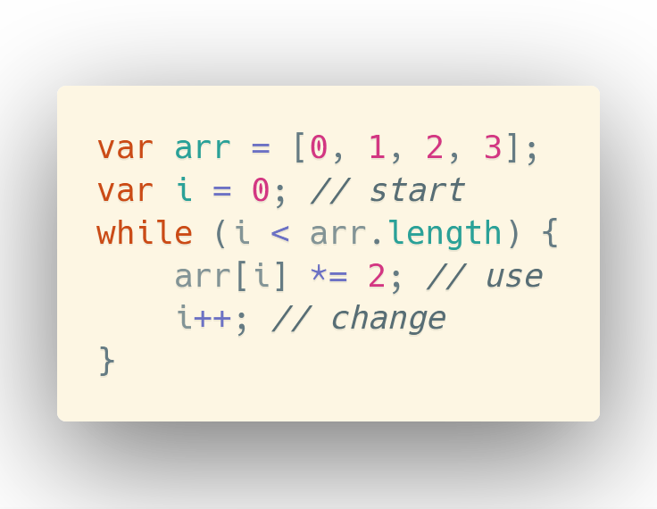

Slide 4
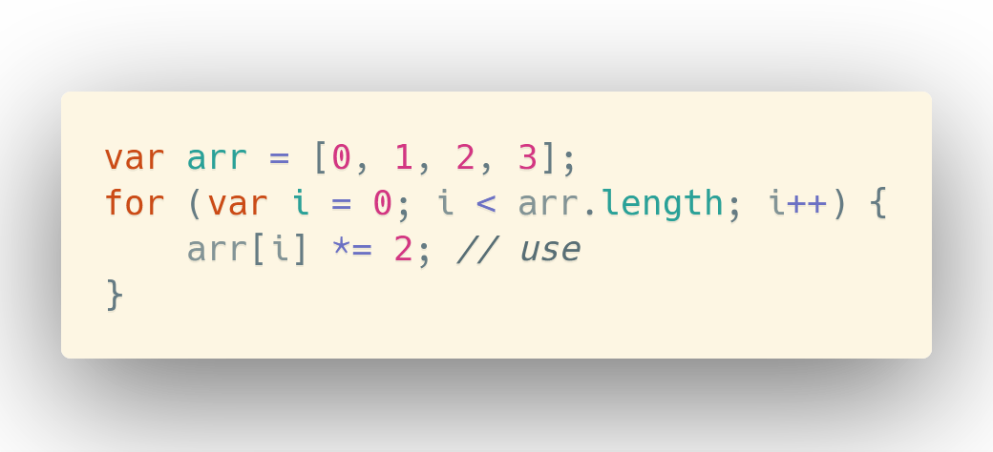

Slide 5
Object-Oriented Programming

Slide 6
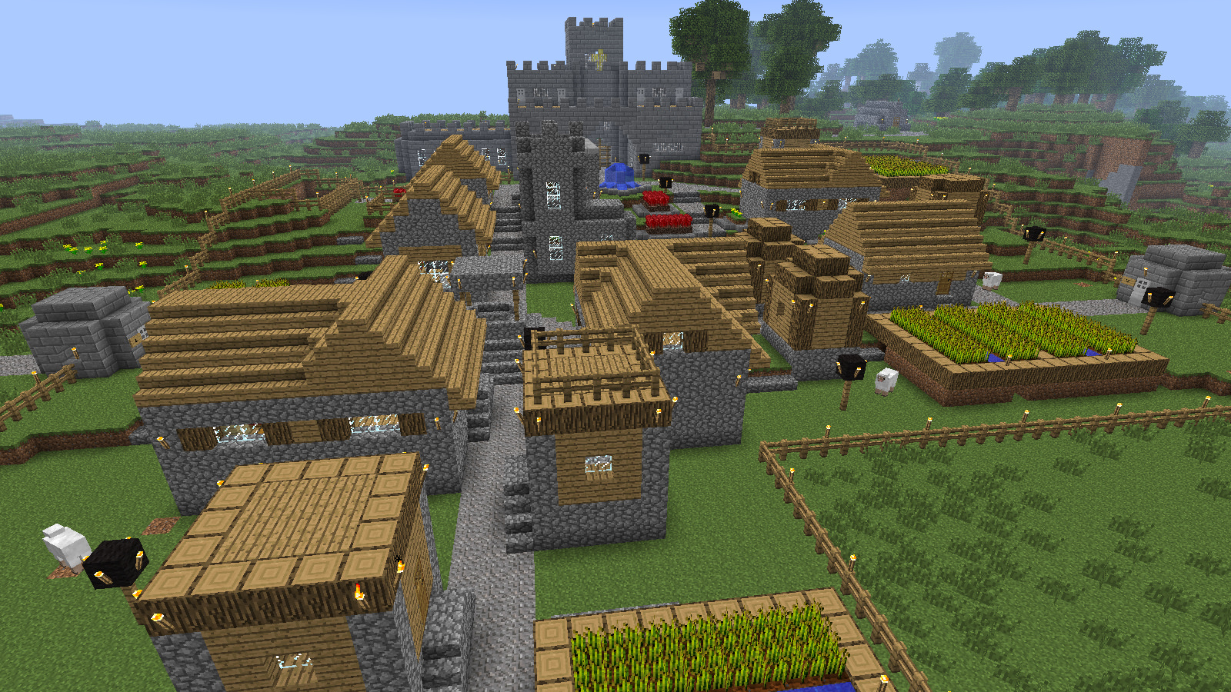

Slide 9


Slide 10
PLAYER
X: 234.5657
Y: 34562.452
DIRECTION: LEFT
X-SPEED: 0
Y-SPEED: 0
JUMPING: false
ALIVE: true
ON-LOG: false
COSTUME: chicken
ADORABLE: true

Slide 11
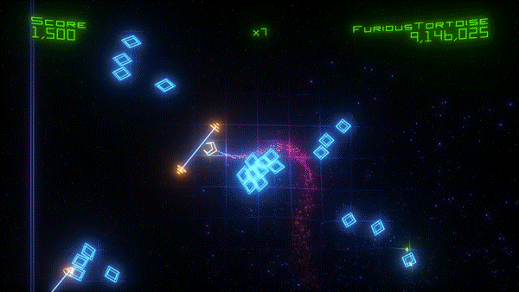

Slide 12
Particle Systems
We’re going to make two functions
updateAndDrawParticle(particle)
createFirework(x, y)
And use this format:
Particles have x, y, xSpeed, ySpeed, color, size

Slide 13
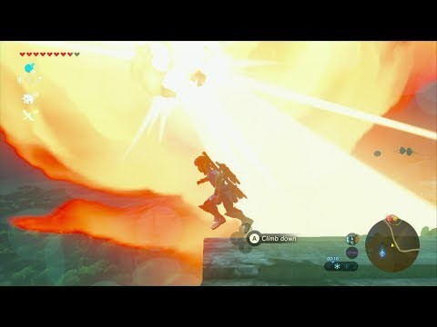

Slide 14


Slide 15
PARTICLE
x: -234.45
y: -35.353
xSpeed: -3.2
ySpeed: -0.8

Slide 16
[ ]

Slide 17


Slide 18


Slide 19
color(255, 255, 0, 255);

Slide 20
pixels
#, #, #, #, #, #, #, #, #, #, #, #, #, #, #, #, 255, 255, 0, 255, #, #, #, #, #, #, #, #

Slide 21

data
https://p5js.org/reference/#/p5/loadStrings

Slide 22
[
]
,
,
,
,
,
,
,
,
,
,
loadStrings

Slide 23
Final Projects Soon
What topics do you want to learn about?
Write them on your minute surveys.
Grab bag next week
Video lessons too

